Slide 1
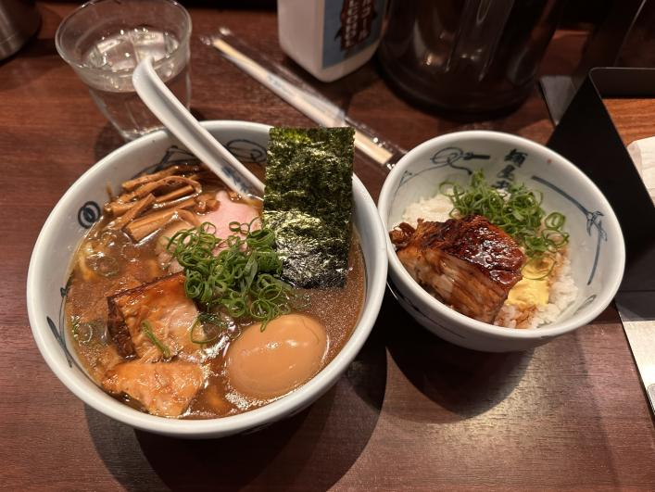
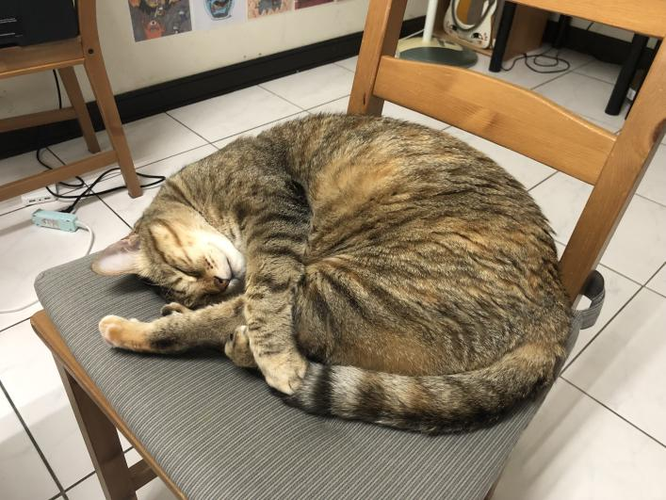
Personal Introduction & How Has This Work Experience Benefited You?
Name: Si-Yuan Huang
Hobbies: Cats, Ramen
How has this experience benefited you?

Slide 2
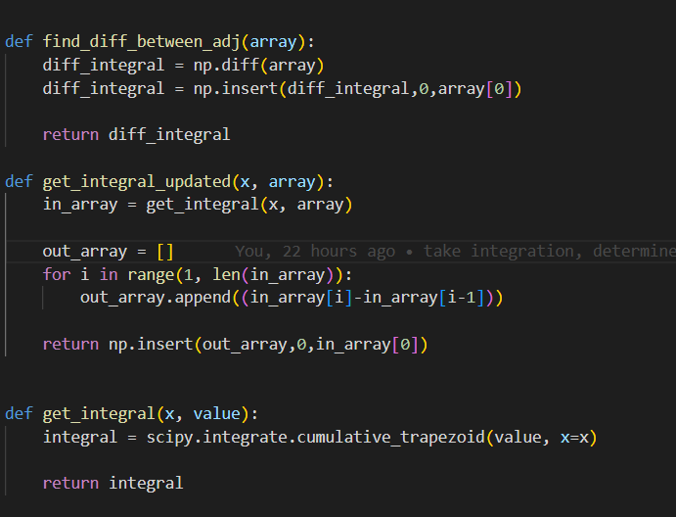
Stage 1 Projects: Group 1G: Integrating
Tell us:
Investigate integration method
Convert raw data in volt to number of proton
Bulk integration

Slide 3
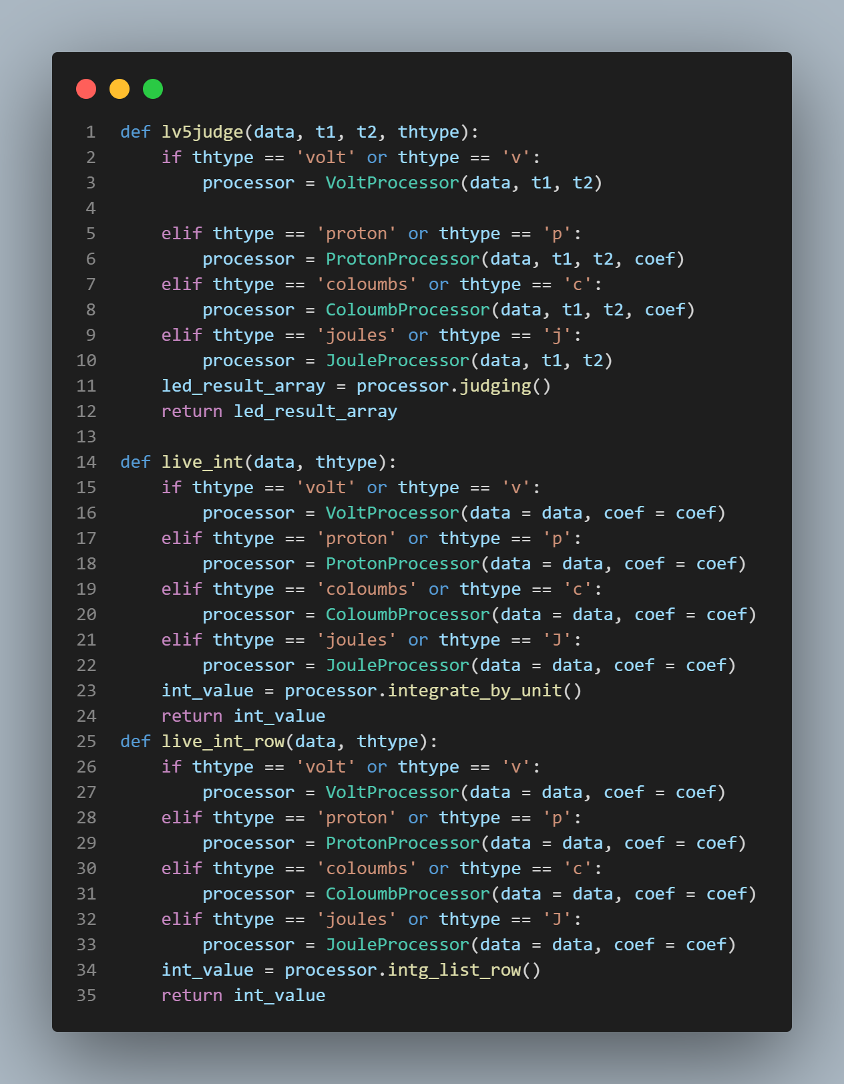
Stage 2 Projects: Waterfall GUI
Backend
Convert units volt/proton/coloumbs/joules
Integrate data by their units
Determine the bean loss data.

